Slide 1
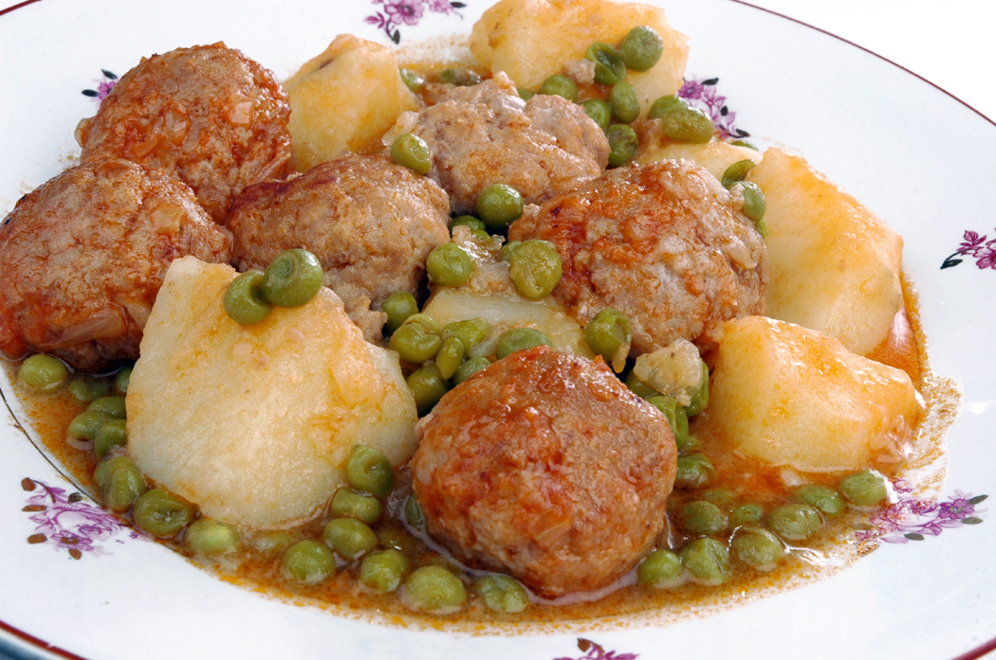
A sound investment
Years of Proven Success

Slide 2
Stable History

Slide 3
Financial History
Latest Figures
Fiscal Year 2015 Annual Report
Quarter Ended | 1st Qtr. | 2nd Qtr. | 3rd Qtr. | 4th Qtr. | Total
Fiscal year 2013
Revenue | $7,746 | $8,541 | $7,835 | $8,065 | $32,187
Gross profit | 6,402 | 6,404 | 6,561 | 6,761 | 26,128
Net income | 2,041 | 1,865 | 2,142 | 1,483 | 7,531
Fiscal year 2014
Revenue | $8,215 | $10,153 | $9,175 | $9,292 | $36,835
Gross profit | 6,735 | 7,809 | 7,764 | 7,811 | 30,119
Net income | 2,614 | 1,549 | 1,315 | 2,690 | 8,168
Fiscal year 2015
Revenue | $9,189 | $10,818 | $9,620 | $10,161 | $39,788
Gross profit | 7,720 | 8,896 | 8,221 | 8,751 | 33,588
Net income | 2,528 | 3,463 | 2,563 | 3,700 | 12,254

Slide 4
A Bright Future

Slide 5
Market Summary Analysis
Sales Projections
Market Distribution
Financial Summary
Our perennial 3rd Quarter boost was larger than expected contributing to an exceptionally strong year. Sales for all locations looks fairly steady.
Our new store opened this year. We expect to see substantial revenue contribution from this location over the next two years.

Slide 6
Business Summary
Business Process Model
Cost
Watch Waste
Service
Customer First
Summary
This has been a pivotal year for the company in terms of growth. The new location is experiencing tremendous success, and same-store sales growth has topped 7% for all locations.

